Slide 1

MICROPROCESSOR AND COMPUTER ARCHITECTURE LABORATORY
4TH Semester(UE19CS256)
Class 6 Week5
Friday, February 19, 2021
Prof Deepti C
Computer Science and Engineering

Slide 2

Microprocessor & Computer Architecture Laboratory
WEEK 4 | Write an ALP to display Hello World Write an ALP to find the length of a given string Write an ALP to copy string from one location to another Write an ALP to find whether a given character is present in a string. If present, find how many times the given character is present in a string.

Slide 3
Microprocessor & Computer Architecture Laboratory
WEEK 5 | PROGRAM 1
Write an ALP to display Hello World
Algorithm 1.Initialise R1 to contain the address of the string 2.Copy each character from the string into register R0(Use LDRB instruction) 3.Check if the character in R0 is zero 4.If valid character is found, display character(use SWI 0x00) 5.Increment R1 to point to next character in the string 6.Repeat step 3 to 5 until end of string 7.End Program |  | Before Execution .data str: .asciz "Hello”

Slide 4
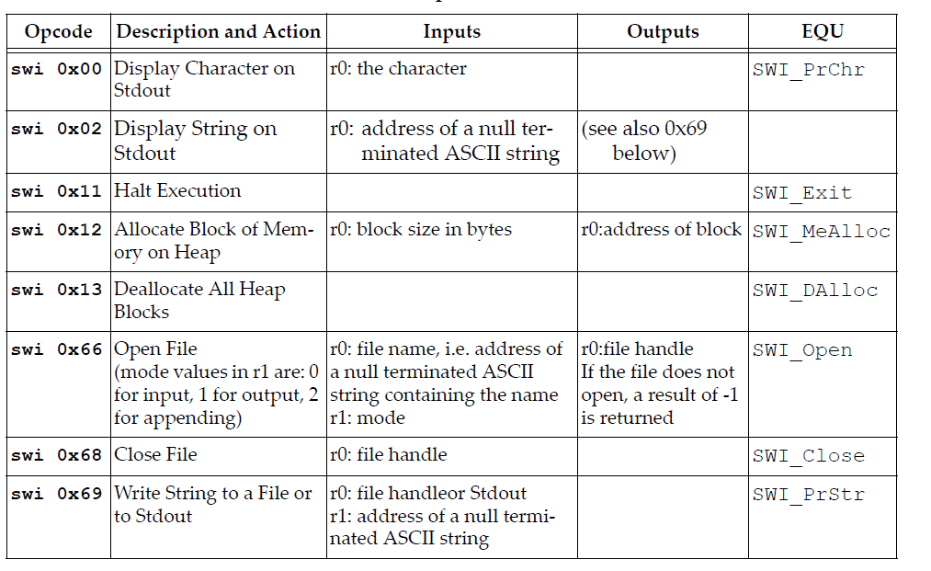
SWI #

Slide 5
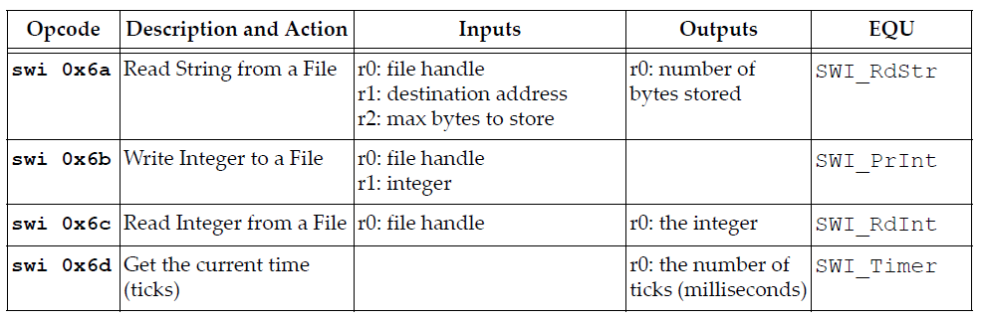
SWI #

Slide 6
A program to display a string on the screen using ARM ALP.
printf(“ Hello World”);
LDR R1, =A
LOOP: LDRB R0, [R1], #1
CMP R0, #0
SWINE 0x00 ; display a character on the screen.
BNE LOOP
SWI 0x11 ; terminate the program.
.DATA
A: .ASCIZ “HELLO WORLD”

Slide 7
Microprocessor & Computer Architecture Laboratory
WEEK 5 | PROGRAM 2
Write an ALP to find the length of a given string
Algorithm 1.Initialise R0 to contain the address of the string 2.Let R1=0=Initial length of the string 3.Copy each character from the string into register R2(Use LDRB instruction) 4.Check if the character in R2 is zero 5.If valid character is found, increment R1. 6.Else end Program 7.Increment R0 to point to next character in the string 8.Repeat step 3 to 5 until end of string 9.R1 contains final length of string 10.End Program |  | Before Execution .data str: .asciz "Hello“ After Execution R1=00000005

Slide 8
Microprocessor & Computer Architecture Laboratory
WEEK 5 | PROGRAM 3
Write an ALP to copy string from one location to another
Algorithm 1.Initialise R0 to contain the address of the string srcstr 2.Initialise R1 to contain the address of the string dststr 3.Copy character from srcstr to R2 4.Copy character from R2 to dststr 5.Check if character in R2 is valid character 6.Repeat step 3 to 5 until end of srcstr 8.Display dststr using SWI0x02 9.End Program |  | Before Execution .data srcstr: .asciz "PES UNIVERSITY" dststr: .asciz "aaaaaaaaaaaaaa" After Execution dststr: "PES UNIVERSITY"

Slide 9
Microprocessor & Computer Architecture Laboratory
WEEK 5 | PROGRAM 4
Write an ALP to find whether a given character is present in a string. If present, find how many times the given character is present in a string.
Algorithm 1.Initialise R0 to contain the address of the string 2.Initialise R1 to contain the address of the key character to be searched 3.Copy key character to R3 4.Copy character from string to R2 5.Compare characters in R2 and R3 6.If equal ,key character found. Increment R5 7.Else,repeat step 3 to 5 until end of str 8.R5 contains number of times key appears in string 9.End Program |  | Before Execution .data Str: .asciz "hello world" Char: .asciz "l“ After Execution R5=00000003

Slide 10
THANK YOU
Deepti C
Department of Computer Science and Engineering
deeptic@pes.edu

